Slide 1
HSA System Emulation and
Performance Evaluation
Shih-Hao Hung
Performance, Applications, and Security Lab
National Taiwan University

Slide 2
Evolution of Computing Systems
Single processor with unsatisfying performance
Hardware acceleration: Task partitioning for efficiency
  for I/O
  for network
  for encoding/decoding
  for graphics
Special-purpose processors: Programmable/Efficient
  Network Processors, DSP’s, GPU’s,...
Reconfigurable hardware (FPGA): Efficient/Programmable
Homogeneous multicore: Data parallelism
Cloud computing: Scalability
Heterogeneous systems: may include any of above
Shih-Hao Hung, NTU-CSIE

Slide 3
Complexity in Systems Research
Today, computers are complex and heterogeneous
  New smartphones have 4~8 cores and sophisticated SW
  Even embedded systems have multiple CPU and GPU cores
  A cloud system consists of a large number of computers
  Mobile cloud computing emphasizes on inter-operability for smooth and transparent interactions
Good for application developers and makers
  Many powerful and convenient HW/SW kits available
  Makes it easy to change the world (in your own way)
However, leading-edge systems engineering/research is harder than ever
Shih-Hao Hung, NTU-CSIE

Slide 4
How to Produce Leading-Edge Products?
Applications as innovative as possible
Time to market as short as possible
Development skills as low as possible
Performance as fast as possible
Power and Energy as efficient as possible
Size as small as possible
Shih-Hao Hung, NTU-CSIE

Slide 5
Heterogeneous Systems
Good in performance and efficiency, but
  Unconventional
  Hard to design and program
  Complex
Solving these technology barriers
  Skills of research and innovation are needed to solve unconventional problems
  Learning new methodologies and knowledge to handle the issues
  Use of design tools and virtualization technology to address complexity
Shih-Hao Hung, NTU-CSIE

Slide 6
Satisfying the Needs for Systems R&D
Tools to reduce difficulties and increase productivity
  Libraries, Debuggers, Simulators,...
  Assist the design and verification processes
  Make it easy to search the design space
  Shorten time-to-market
What are missing?
  Experiences: Exploring the new world is very different from copying designs, reverse engineering, or cost-down
  (BTW, skilled hands are needed badly now...)
  Virtual Platforms: Playgrounds which mimic real systems are needed for experimenting new ideas/designs
Shih-Hao Hung, NTU-CSIE

Slide 7
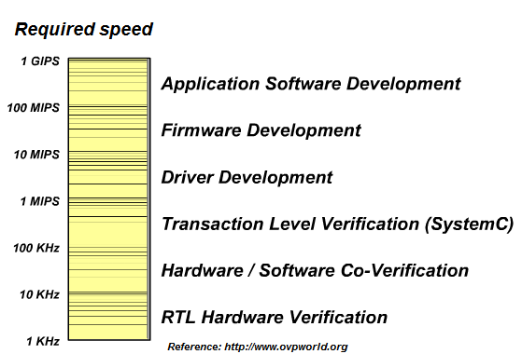
Virtual Platforms
Virtual platforms are used for years in HW design
  Have you written any Verilog or VHDL code lately?
  Circuit-level simulators (Analog design, SPICE)
  Logic-level simulators, a.k.a. register-transfer-level (RTL)
  Transaction-level modeling (TLM)
  Electronic System Level (ESL)
Unfortunately, these are very very slow!
Wanted for
HW/SW Codesign!
Shih-Hao Hung, NTU-CSIE

Slide 8
What Are Wanted for HW Design?
Verification: Detailed cycle-by-cycle RTL model
Architecture study:
  Processor pipeline model
  Branch prediction model
  TLB model
  Private cache model
  Cache coherence model
  Memory model
  I/O bus model
  I/O device model

Slide 9
Need Everything for HW Design?
Verification: Detailed cycle-by-cycle RTL model
Architecture study:
  Processor pipeline model
  Branch prediction model
  TLB model
  Private cache model
  Cache coherence model
  Memory model
  I/O bus model
  I/O device model

Slide 10
What Are Wanted for Software Design?
System-wide profiling, monitoring and tracing
  Performance analysis, e.g. hot functions, HW/SW interactions
  Behavior analysis, e.g. security model for malware detection
    Wen-Chieh Wu and Shih-Hao Hung. DroidDolphin: a Dynamic Android Malware Detection Framework Using Big Data and Machine Learning, in Proc. the 2014 Research in Adaptive and Convergent Systems (RACS 2014), Towson, US, October 5-8, 2014.
  Full-system power consumption analysis
  Guidance for real-time programming
Current and parallel programming
  Resolving race conditions for shared resources
  Identification of performance bottlenecks
  Visualizing interprocessor communications & synchronization
  Guidance for heterogeneous computing

Slide 11
Parallel Smart Event Tracing
OpenCL Application
Linux Kernel
Target System
Host System
PQEMU
GPU Simulator
CPU
Emulator
VPMU
PI
PI
Event
Collector
Trace
Analysis
Tools
Buffer
Tracing
Control
Tool
Tracing
Engine
Disk
: Modeling related
: Tracing related

Slide 12
Advantage for In-Emulation Tracing?
Traditional tracing techniques are ad-hoc
  Require HW and/or SW instrumentation → Poor portability
    HW instrumentation is nearly impossible for most users
    SW instrumentation may require deep knowledge on OS, runtime software and compiler tools
  Intrusiveness: Need to remove the overhead of instrumentation
In-Emulation Tracing
  Instrumentation in QEMU works for virtually any popular ISA, OS and software → high portability
  HW models can be added for HW analysis
  HSA GPU or FPGA can also be added to emulate heterogeneous systems

Slide 13
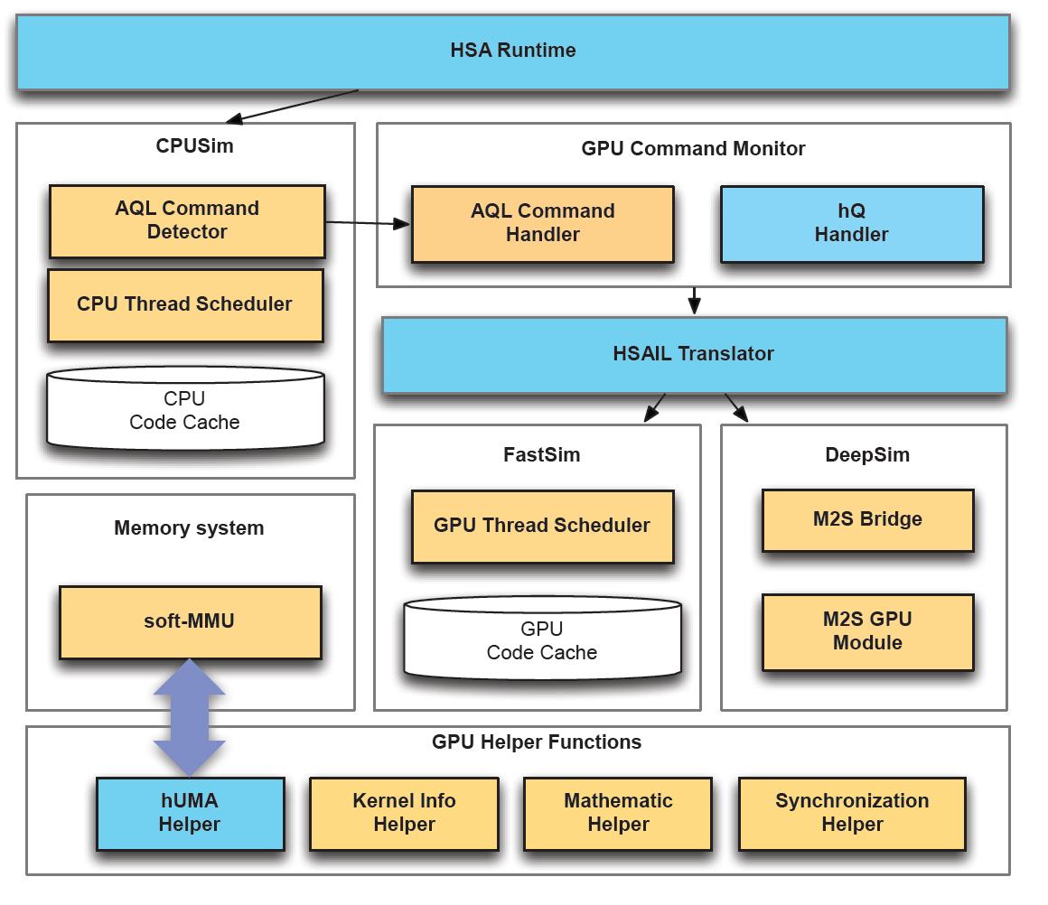
HSAemu
First functional emulator for HSA
Created by Prof. Yeh-Ching Chung at NTHU.
Published recently in a top conference:
Jiun-Hung Ding, Wei-Chung Hsu, Bai-Cheng Jeng, Shih-Hao Hung and Yeh-Ching Chung. HSAemu – A Full System Emulator for HSA Platforms, in International Conference on Hardware/Software Codesign and System Synthesis (CODES+ISSS 2014), New Delhi, India, October 12-17, 2014.
Shih-Hao Hung, NTU-CSIE

Slide 14
Making HSAemu Better?
In-Emulation Tracing
Performance optimization for applications
  Find software bottlenecks on single-threaded applications
  Help parallelize application with OpenCL/Sumatra/…
  Evaluate performance for OpenCL/Sumatra applications
Performance evaluation for systems
  Support early-stage architecture design
  Help define and test hardware-software interface
  Enable early-stage system software design

Slide 15
Moving Old Tricks to HSAemu
MCEmu
  Chia-Heng Tu, Shih-Hao Hung, and Tung-Chieh Tsai. 2012. MCEmu: A Framework for Software Development and Performance Analysis of Multicore Systems. ACM Trans. Des. Autom. Electron. Syst. 17, 4, Article 36 (October 2012).
System Evaluation
  Shih-Hao Hung, Chi-Sheng Shih, Tei-Wei Kuo, Chia-Heng Tu, and Che-Wei Chang, A Real-Time, Energy-Efficient System Software Suite for Heterogeneous Multicore Platforms, in International Conference on Hardware/Software Codesign and System Synthesis (CODES+ISSS 2012), Tampere, Finland, October 7-12, 2012.

Slide 16
MCEmu

Slide 17
The MCEmu Framework
Applications
Multicore Applications
Tools and Library
Software development tool
Board support package
Smart event tracing unit
Virtual performance monitoring unit
Parallel simulation framework
Software Development Kit
Tracing/Profiling Tools
Inter-core communication
System Software
Linux
Board Support Package
System Emulator (QEMU)
Processor/Device Simulators
System-Level Emulation/Simulation
Main Processor(s)
Virtual Performance Monitoring Unit
Special Purpose Processor #1
System Bus
Special Purpose Processor #2
Virtual I/O Devices
Realtime Clock & Memory System
Smart Event Tracing Unt
Device Simulator
Host
Host System (Multicore)

Slide 18
MCEmu Framework – Virtual Performance Monitoring Unit
Inst. stream
Applications and performance tools
Model and simulator selection, & power setting adjustment
External architecture models
Performance counter
Performance counter
Math model
Performance counters
Estimated cycle count
Estimated Power/Energy
Platform emulator
CPU events
Joint estimators
Power calculator
Pipeline simulator
Cache events
Timing model 1
(Fast, rough)
Current voltage status register
Cache simulator
Mem. events
Timing model 2
Timing model 3
(Slow, accurate)
Current freq. status register
Mem. simulator
Disk events
Disk simulator
VTD
VPD
Control path
Data path
VPMU
Notes:
Note that the VTD is resident in each processor, so the CPU events and cache events should be located in the located in the VTD when modeling multicore processor

Slide 19
MCEmu Framework – Virtual Performance Monitoring Unit
VPMU organization for multicore processors
Performance counter
System performance counters
Estimated cycle count
Performance counter
Global clock
Joint estimators
Estimated Power/Energy
System power/energy
Performance counters
Power calculator
CPU events
VPD
Coherence cache events
Cache events
Mem. events
VTD
Processor core #1
Disk events
VTD
VPD
Processor core #2
VPMU
VTD
VPD
Processor core #3

Slide 20
MCEmu Framework – Smart Event Tracing Unit
Application & OS
Inst. stream
Performance tools
Event registration device
System performance counters
VTD
VPD
Process name
Processor core #1
Operating mode
Global clock
VTD
VPD
Performance events
System power
Processor core #2
Coherence cache events
Event filtering engine
VTD
VPD
Mem. events
Processor core #3
Disk events
…
Trace record buffer
VPMU
Control path
Data path
SETU
Trace file
convert
Performance visualization tool

Slide 21
Virtual Performance Analyzer

Slide 22
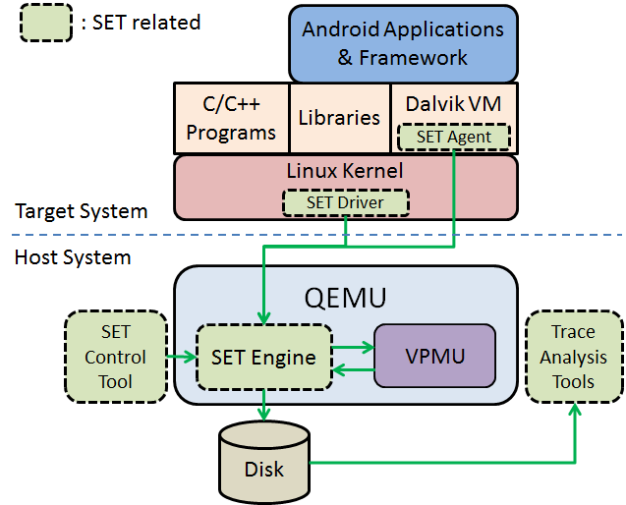
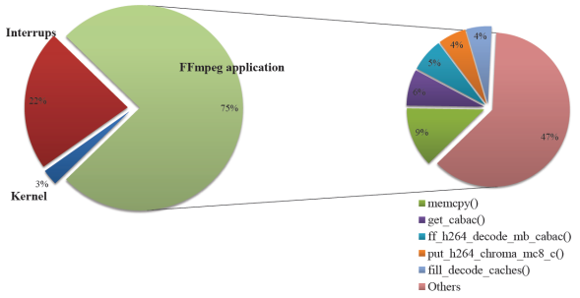
Design for Android Systems
Virtual Performance Analyzer (VPA) supports performance analysis and systems design for Android
  Hook necessary component simulators to model and monitor performance & power (VPMU)
  Trace HW/SW events with Smart Event Tracing (SET) engine, driver, and agent
  Run Android/Linux with minimum porting efforts and observe w/ friendly tools
  User may start experiment with optimization tricks, e.g. changing cache sizes, adding crypto accelerators, revising drivers, applying DVFS techniques, etc.
2011 ESWEEK Android Competition 4th Place
    Shih-Hao Hung, Tei-Wei Kuo, Chi-Sheng Shih, and Chia-Heng Tu. System-Wide Profiling and Optimization with Virtual Machines, in Proc. 17th Asia and South Pacific Design Automation Conference (ASP-DAC 2012), pp. 395 - 400, Sydney, Australia, Jan. 2012. (EI)
Shih-Hao Hung, NTU-CSIE

Slide 23
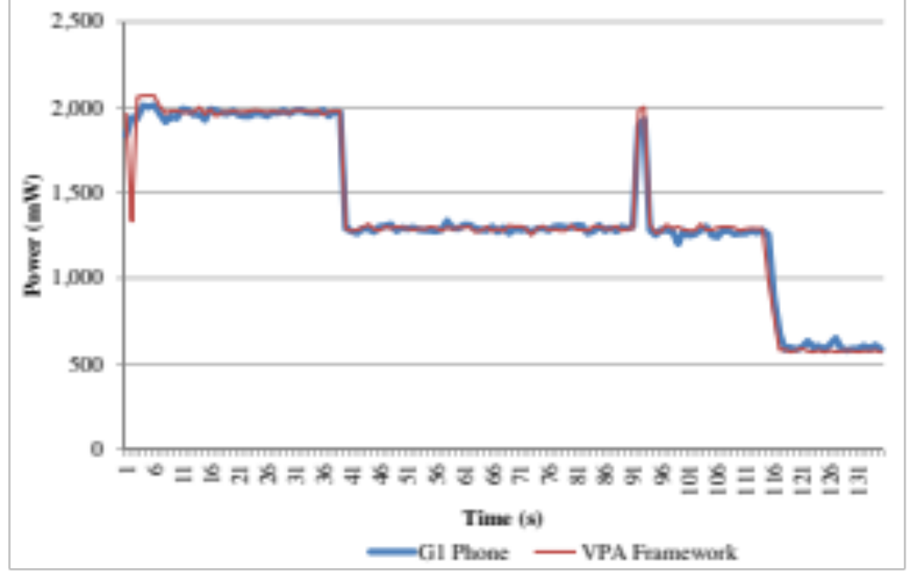
Estimate of Power Consumption w/ VPA
    Shih-Hao Hung, Jen-Hao Chen, Chia-Heng Tu and Jeng-Peng Shieh. Exploring the Design Space for Android Smartphones, in Proc. The Eighth International Conference on Innovative Mobile and Internet Services in Ubiquitous Computing (IMIS-2014), London, United Kingdom, July 2-4, 2014.
Measured by instrumentation or external power meter – data collection overhead, limited information, usability
VPA – Systematically generated model, fast and accurate enough, no need for actual hardware, deployable in cloud
Shih-Hao Hung, NTU-CSIE

Slide 24
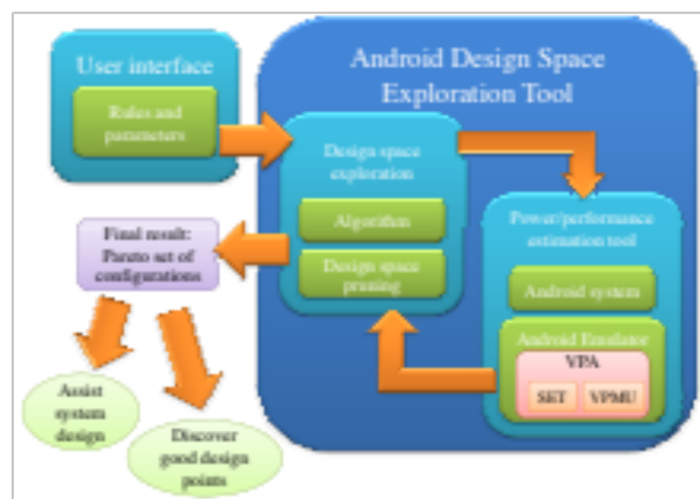
Finding Optimal Solutions in Virtual Space
HW:
CPU: big.LITTLE
GPU
Cache
Memory
I/O Devices
SW:
OS tunables
Applications
    Shih-Hao Hung, Jen-Hao Chen, Chia-Heng Tu and Jeng-Peng Shieh. Exploring the Design Space for Android Smartphones, in Proc. The Eighth International Conference on Innovative Mobile and Internet Services in Ubiquitous Computing (IMIS-2014), London, United Kingdom, July 2-4, 2014.
Shih-Hao Hung, NTU-CSIE

Slide 25
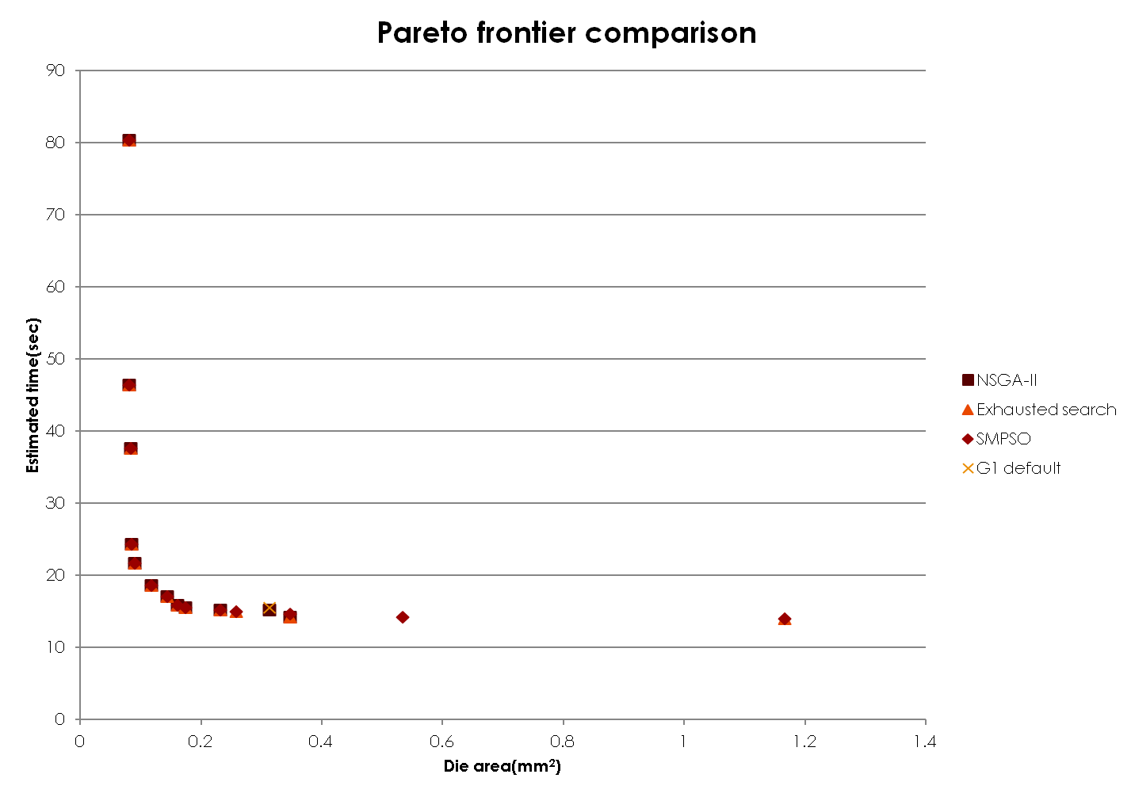
Configurations | 1 | 2 | 3 | 4 (G1) | 5 | 6
Cache size (KB) | 8 | 8 | 32 | 32 | 32 | 132
Associativity | 1 | 4 | 4 | 4 | 2 | 2
Block size (Bytes) | 512 | 32 | 128 | 32 | 32 | 128
Subblock size (Bytes) | 64 | 32 | 32 | 32 | 32 | 32
Write allocate? | N | Y | Y | Y | Y | Y
Replacement policy | FIFO | Random | LRU | LRU | LRU | FIFO
Die area (mm²) | 0.081 | 0.118 | 0.258 | 0.3130 | 0.348 | 1.167
Estimated execution time (ms) | 80,302 | 18,582 | 14,961 | 15,546 | 14,169 | 14,016
(NOTE: Processing technology is 65nm)
①
②
④
③
⑤
⑥

Slide 26
Cache Simulation for Multicore

Slide 27
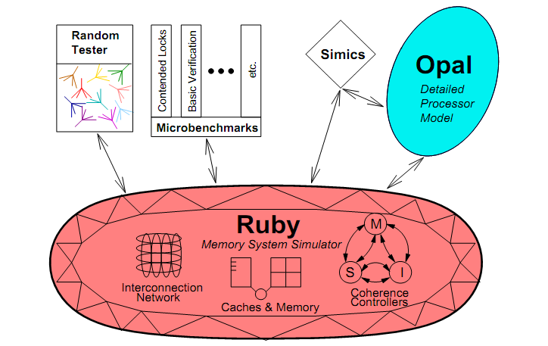
Cache Simulator - GEMS
Detailed memory system simulation model that can simulate a wide variety of memory hierarchies and support many different cache coherence protocols
Baseline: singled threaded, very slow
Shih-Hao Hung, NTU-CSIE

Slide 28
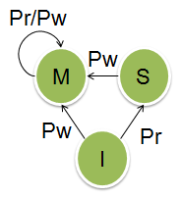
Parallel Cache Simulation
Need to figure out 4C:
  Compulsory misses
  Conflict misses
  Capacity misses
  Coherence misses
First 3C are within a processor
  Identified by standard cache simulators
Approximate coherence misses with parallel method
L1 cache
L1 cache
L1 cache
L1 cache
Host
P1
P2
P3
P4
Shih-Hao Hung, NTU-CSIE

Slide 29
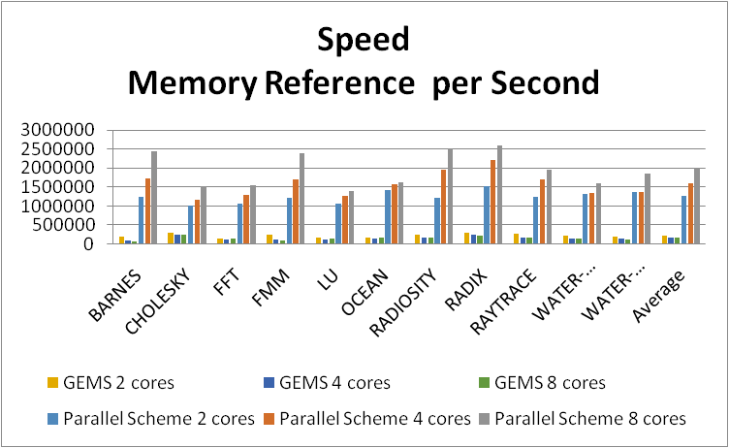

Parallel Cache Simulation Scheme
Simulation speed could be enhanced with integrating lab’s previous work
  (2012) Hui-Hsin’s M.S. Thesis on parallel cache simulator
  (2014) Jen-Jong’s M.S. Thesis on cache simulator for HSA
Notes:
這是實驗室去年學長所開發的parallel cache simulation framework，
可以平行的模擬cache system，
當模擬核心數量越多，加速效果越顯著，
我們未來會將此framework整合進來提高模擬速度。

Slide 30
Non-deterministic Communications
Approximation? Memory access order in a MIMD system within a parallel region are non-deterministic anyway
Refi,p
Refi,q
Refi, p
Refi, q
Refi, j
Refi, q
Time
Case 1: no overlap
Case 2: partial overlap
Case 3: total overlap
Shih-Hao Hung, NTU-CSIE

Slide 31
Required Communications
Minimum number of coherence misses occur when there is no overlap
Easy to calculate
  RAW
  WAR
  WAW
Refi,p
Refi,q
Time
Case 1: no overlap

Slide 32
Estimating Optional Communications
Ri,j: read references to cache line i by core j
Wi,j: write references to cache line i by core j
Refi,j: the union set of Ri,j and Wi,j
Range(X): length of memory reference range, where X is the set of memory reference
    L: length of the overlap region
    鄭人榮 碩士論文 台大資工所 2014
Shih-Hao Hung, NTU-CSIE

Slide 33
System Architecture Overview
System Emulator:
  Insert VPMU for performance profiling
  Coordinate synchronization for each simulator
SSLAB GPU:
  Provide GPU runtime performance information
  Coalesce GPU memory traces
Cache Simulator:
  Simulate 3C cache simulation
  Evaluate cache coherence by analytic model
HSA Application
HSA Runtime API
Guest OS
PQEMU
SSLAB GPU
VTD
Processors
Execution Engine
Translation engine
Command Monitor
VPMU
I/O Device
Cache Simulator
Analytic
model
3C Cache
Simulation
Trace
buffer

Slide 34
SSLAB GPU emulator
Command Monitor
  Notify VPMU to enable GPU timing device
Virtual Timing Device
  Calculate GPU local timing
    ex: GPU CU local time = instruction counts * average CPI * CPU Fre/ GPU Fre
Memory helper function
  Count instructions
  in runtime
  Generate memory traces
  Reschedule memory
  traces
HSA API
VPMU
HSA monitor
notify
update GPU local time
Task dispatch
VTD
HSA CU threads
Instruction
counts
Memory access
Cache
Simulator
Trace sender
Global_load
Global_store
traces
traces

Slide 35
Experiments (Jen-Jong Cheng, 2014-07)
Host System
  32 Intel Xeon E5-2660 2.2GHz processor, 16GB DDR3
  Ubuntu-12.04 (64bit)
Virtual platform
  PQEMU-0.13 + SSLAB GPU + Multi2Sim
  ARM Realview-PBX-a9, support up to 4 cores
Benchmark
  AMD OpenCL
  Splash2 benchmarks (CPU benchmarks)
  Srad (OpenCL with shared memory)
Cache Configuration
  16KB cache size, 4 way, 32B cache line size, 128 cache sets
Shih-Hao Hung, NTU-CSIE

Slide 36
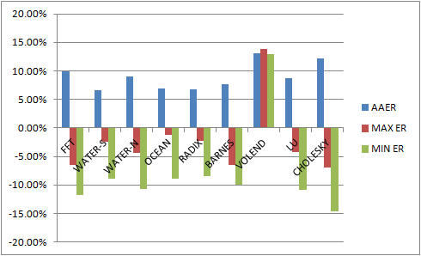
Accuracy, Compared to GEMS
Splash benchmark with 4 threads on 4 ARM cores
AAER = Average Absolute Error Rate
One thousand memory references trigger the synchronization.
Shih-Hao Hung, NTU-CSIE
    鄭人榮 碩士論文 台大資工所 2014

Slide 37
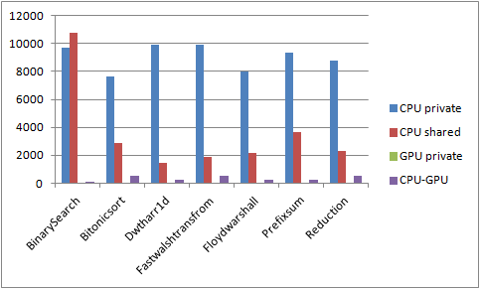
Example of Cache Misses Analysis
    鄭人榮 碩士論文 台大資工所 2014
Shih-Hao Hung, NTU-CSIE

Slide 38
FPGA Accelerators
Intel and FPGA
  http://www.extremetech.com/extreme/184828-intel-unveils-new-xeon-chip-with-integrated-fpga-touts-20x-performance-boost
Video demo from Altera & Xilink
  https://www.altera.com/products/design-software/embedded-software-developers/opencl/overview.highResolutionDisplay.html
  http://www.xilinx.com/products/design-tools/sdx/sdaccel.html

Slide 39
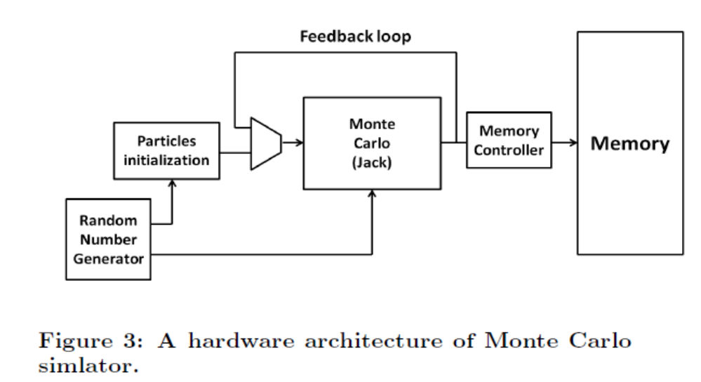
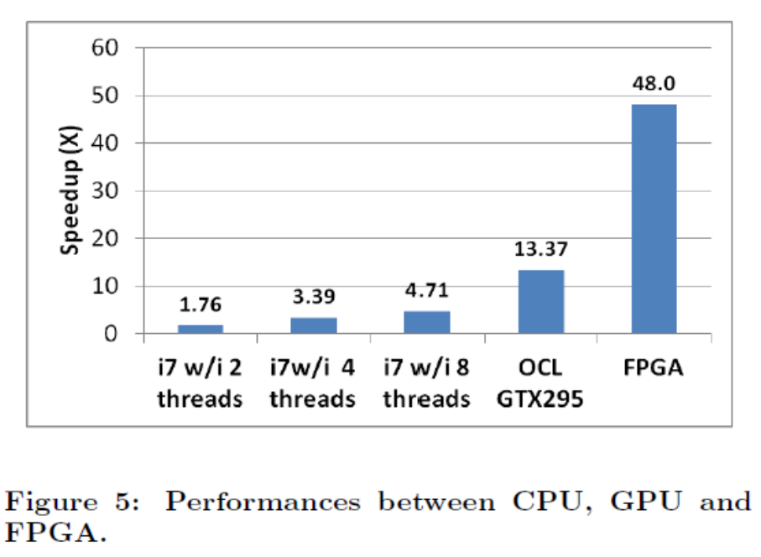
FPGA Acceleration
Potential for higher power-performance ratio than GPU
Keys:
  Data copies can be done by wires
  Intensive simple integer operations
  Conversion of loops into pipelines
  Can be placed in-line

Slide 40
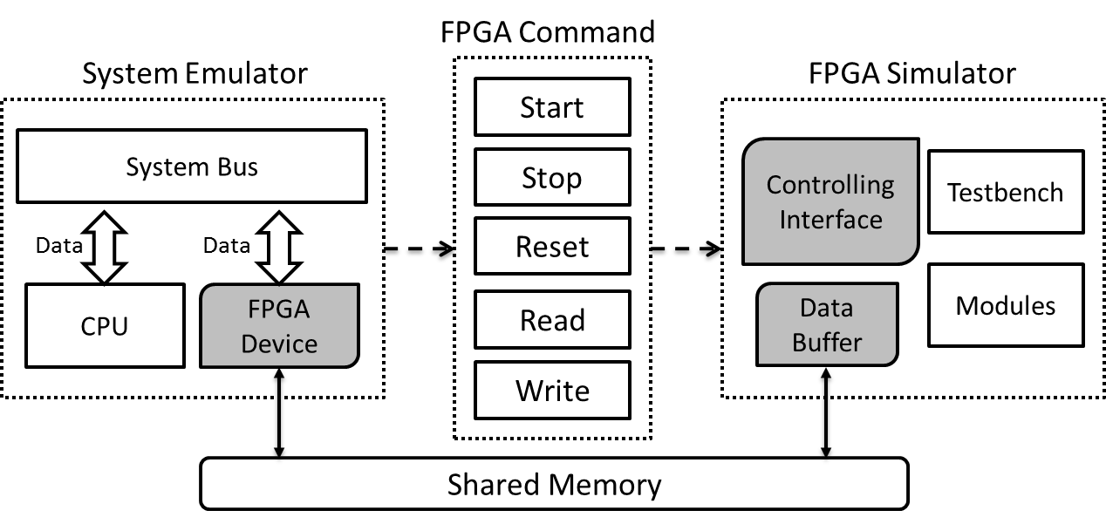
Connecting an FPGA Simulator to QEMU (1/2)
System Emulator:
    Contains an FPGA device, accessible from Linux and apps
    Transfer FPGA commands and simulation data to FPGA simulator
    Shih-Hao Hung, Tien-Tzong Tzeng, Jyun-De Wu, Min-Yu Tsai,Yi-Chih Lu, Jeng-Peng Shieh, Chia-Heng Tu, Wen-Jen Ho. MobileFBP: Designing portable reconfigurable applications for heterogeneous systems, in Journal of Systems Architecture, Volume 60, Issue 1, January 2014, Pages 40-51. (SCI)
Notes:
那我們將FPGA simulator連接到系統則是透過上頁所敘述方法，
首先我們先透過系統API來建立虛擬的FPGA device，
並跟VPMU註冊FPGA的performance counter，

Slide 41
Connecting an FPGA Simulator to QEMU (2/2)
FPGA Simulator:
  Controlling Interface implemented with Verilog Procedure Interface (VPI)
  Data Buffer for saving simulation data
Notes:
接下來，
在FPGA simulator內則需要提供給外部模擬器一個控制介面，
這控制介面我們則是利用前面介紹的VPI來實做，
另外還需要一個Buffer用來存放模擬過程所需的資料

Slide 42
Design Hardware Acceleration in Virtual Space
Save time to market and correct designs early
  Profile applications: Finds Performance bottlenecks & Data flow analysis
  Develop accelerator and software support in parallel
  Evaluate strategies with co-simulation
Application
Driver
Machine
Accelerator
In Physical Space
Application
Driver
Virtual Machine
Verilog
Simulator
Virtual Performance Analyzer
In Virtual Space
Shih-Hao Hung, NTU-CSIE

Slide 43
Beyond a Single System

Slide 44
Design for Heterogeneous Clouds
Servers as the basic elements in a cloud system
Design and optimize for big data analytics? In virtual space
Apps on Servers
Heterogeneous Cloud Infrastructure
Web Services
X86
Webkit
X86
Management Facilities
X86
MapReduce
ARM
ARM
WebCL, WebGL
ARM
Performance & Cost Models
OpenCL, OpenGL
GPU
GPU
GPU
Filesystem
Switching Fabric
User Data
GPU
GPU
FPGA
MOST Big Data Project, 2013-2014
Shih-Hao Hung, NTU-CSIE

Slide 45
Accelerating MapReduce
Node 1
Node 2
Attach FPGA boards to accelerate MapReduce
Filtering data at the source to reduce CPU work for query operations
Develop toolkit and API for applications to utilize FPGA for intensive Map and Reduce computation
Compression/decompression engines to reduce network traffics
RDMA engine to reduce overhead of network protocol
Filter on FPGA
Map
Map
Map on FPGA
Network
Compression
RDMA
Shuffle Sort
Shuffle
Sort
Decompression
Reduce
Reduce
Reduce on FPGA
115/11/07

Slide 46
Hardware-Software Co-Design
MapReduce App
Development Toolkit for accelerating MapReduce application with FPGA
  Source code analyzer: Figures out program structure and adds instrumentation code
  Performance profiler: Identifies bottlenecks
  FPGA API: Enables programmer to invoke FPGA for acceleration
  High-Level Language to FPGA Compiler: Help convert HLL to HDL
  FPGA Library: Includes commonly used functions
  Virtual Platform: Allows programmer to debug and test FPGA acceleration
Source Code Analyzer
Performance Analyzer
Non-Critical Path
Critical
Path
FPGA API
HLL-to-HDL Compiler
FPGA Lib
New MapReduce App
Virtual Platform
115/11/07

Slide 47
Conclusion
Systems research is more and more challenging, and it is very important to Taiwan’s industry
Tightly-couple hardware-software design is key to winning, and it can be done effectively with right methodologies and tools
Virtualization technologies and tools can help to build smarter systems from mobile to cloud applications
HSA gets more and more interesting and requires research/innovation skills with knowledge and tools
Lots of opportunities!
Shih-Hao Hung, NTU-CSIE

